Slide 1
Document Search Engine
Introduction to the Document Search Engine with Binary Independence Model, Non-Overlapped Lists, and Proximal Nodes

Slide 2

Overview
Structure-Guided and Hypertext Models:
These are two unique ways to organize and retrieve information.
Designed to make searching and learning more efficient and accessible.

Slide 3
Objective
To understand how these models work and help organize information effectively.
We aim to explore their features, working, and advantages.

Slide 4
Goal
Structure-Guided Model: Simplifies access to organized data structures.
Hypertext Model: Provides seamless navigation between interconnected pieces of information.

Slide 5
Core Features
Structure-Guided Model:
1. Uses hierarchies or predefined structures.
2. Ensures systematic organization.
Hypertext Model:
1. Utilizes interconnected nodes.
2. Focuses on seamless navigation and flexibility.

Slide 6
Core Features
Structure Guided Model:
Information is arranged step-by-step, like a ladder.
Think of it as a treasure hunt where clues lead to the next step!
Hypertext Model:
Information is linked, like a spider web.
You can jump from one link to another, like exploring a cool website!

Slide 7
Working of Structure-Guided Model
1. Information is stored in a predefined structure.
2. Users follow paths to retrieve data.
Example: A library system categorizing books by subject.

Slide 8
Working of Hypertext Model
1. Information is stored as interconnected nodes.
2. Users click links to navigate between nodes.
Example: Wikipedia links connecting various topics.

Slide 9
How They Work
Structure Guided Model:
Information is arranged in a fixed order.
Example: A book where you read from page 1 to the end.
Hypertext Model:
Information is linked through clickable links.
Example: Wikipedia articles where you click on links to explore.

Slide 10
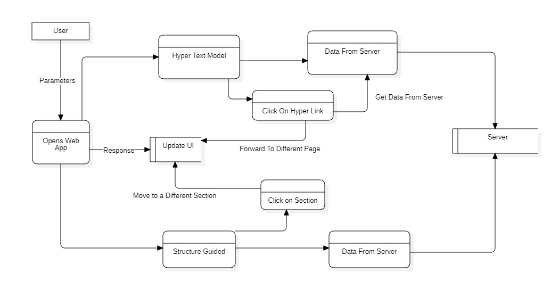
DFD

Slide 11
DFD Explanation
Components:
User: Represents the end-user who interacts with the system.
Hypertext Model: The core of the system, responsible for handling user interactions and retrieving data.
Data From Server: Represents the data fetched from the server in response to user actions.
Server: The backend server that provides the data.
Open Web App: Represents the web application that is opened in response to user actions.
Update UI: Represents the process of updating the user interface based on user actions or data received from the server.

Slide 12
DFD Explanation
Data Flows:
Structure Guided:
Click on Section: The user clicks on a section within the web application.
Move to a Different Section: The user navigates to a different section of the web application.
HyperText Model:
Click on Section: The user clicks on a hyperlink within the web application.
Get Data From Server: Redirect to a different page. The system sends a request to the server to fetch the new Page.

Slide 13

Details
Structure-Guided Model:
Great for tasks needing systematic access.
Hypertext Model:
Ideal for exploring and discovering interconnected ideas.

